Slide 1
Configuration Management
Update as of 03/19/2020
Softura Confidential

Slide 2
MCA Configuration Management
Traceability
Requirements and Design
Requirements and Design
Requirements and design managed in MagicDraw. Artifacts version controlled using revision, tied to CMDB.
Change Management
ClearQuest manages the defects and feature requests; CCB process and Automation Scripts integrated.
Install Base
Change Management
MCA CM
Implementation Artifacts
Code and other artifacts managed in GitHub. Automation script integrated with branching/merging and tagging.
IV&V Artifacts*
IV&V Artifacts being managed in MagicDraw and Spreadsheets. Yet to complete end-end integration.
Reviews & Tollgate
Implementation
Artifacts
Traceability
Reviews & Tollgate
Reviews are recorded in EDR and MagicDraw. Using Selenium UI automation, integrated with EDR.
Install Base*
Locomotive specific config. to be tied to the traceability record in CMDB. (pending integration with eServices)
IV&V Artifacts
* Integration with e-Services yet to be implemented; End-End integration with IV&V artifacts and App containers pending

Slide 3






Solution View
Pending Automation
Automated
CCB
update
Triggers work
query
Dev Team
ClearQuest
update
2a. Verify Tollgate Status
EDR
1. Export query
Automation Scripts
2b. Conformance Check
Trigger Build
eServices
3. Create Release Branch
Jenkins Build
6b. Transmit package
4. Populate CMDB
2c. Create Tags
CMDB
6a. Pull Meta-Data

Slide 4
Completed Deliverables
CMD #1: Design and Setup CMDB Tables that captures the CIs and brings traceability to tie various design artifacts within MD, Code in Git, Test Benches, Build Machine, Software Tools, Hardware Platform etc.
CMD #2: Conformance script to validate Commits (from Release Notes), verify all Peer and Tollgate Review Status associated with the Release Artifacts (integrate with EDR)
CMD #3: Automate Capture of CIs and its Attributes for each type of repository and branch based on tag and Populate CMDB (Soft Links as opposed to an entire copy of the CIs)
CMD #4: Tagging and automate Branch Creation for Releases (Git). Use Tagging for MagicDraw.
CMD #5: Automate Merge from Release branch back to Develop Branch. (Git)
CMD #6: Automate Interface with e-Services
CMD #7: Setup CM Change Management Workflow within ClearQuest aligned with CCB
Softura Confidential

Slide 5
Next Phase Activities
Integrate with Apps dependencies, Hardware and IV&V Artifacts and do an end-end integration
Get access to ClearQuest APIs and possibly DB access or API access to EDR and integrate.
Create Custom Schema for MCA in ClearQuest with state transition rules, role/access matrix implemented and workflow events that can trigger Automation Scripts.
Integrate Automated Merge script with the development process; Integrate Automated Branch Freeze script with the development process
Implementation of UI interface to query CMDB; CMDB Reports & Dashboards – KPIs/Metrics
E-Services Integration
Softura Confidential

Slide 6
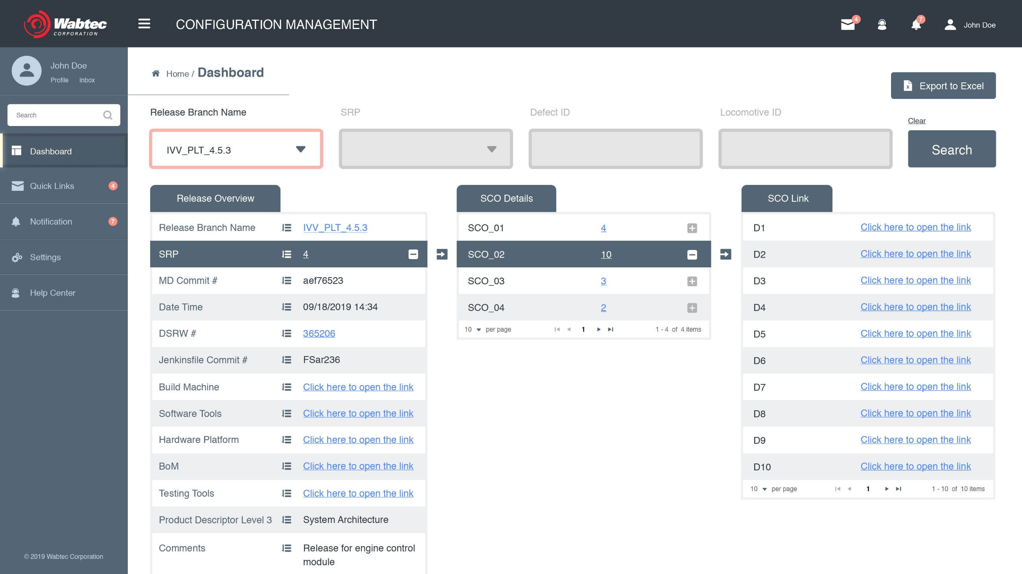
Thinking ahead.. (Future Sprints)
Softura Confidential

Slide 7
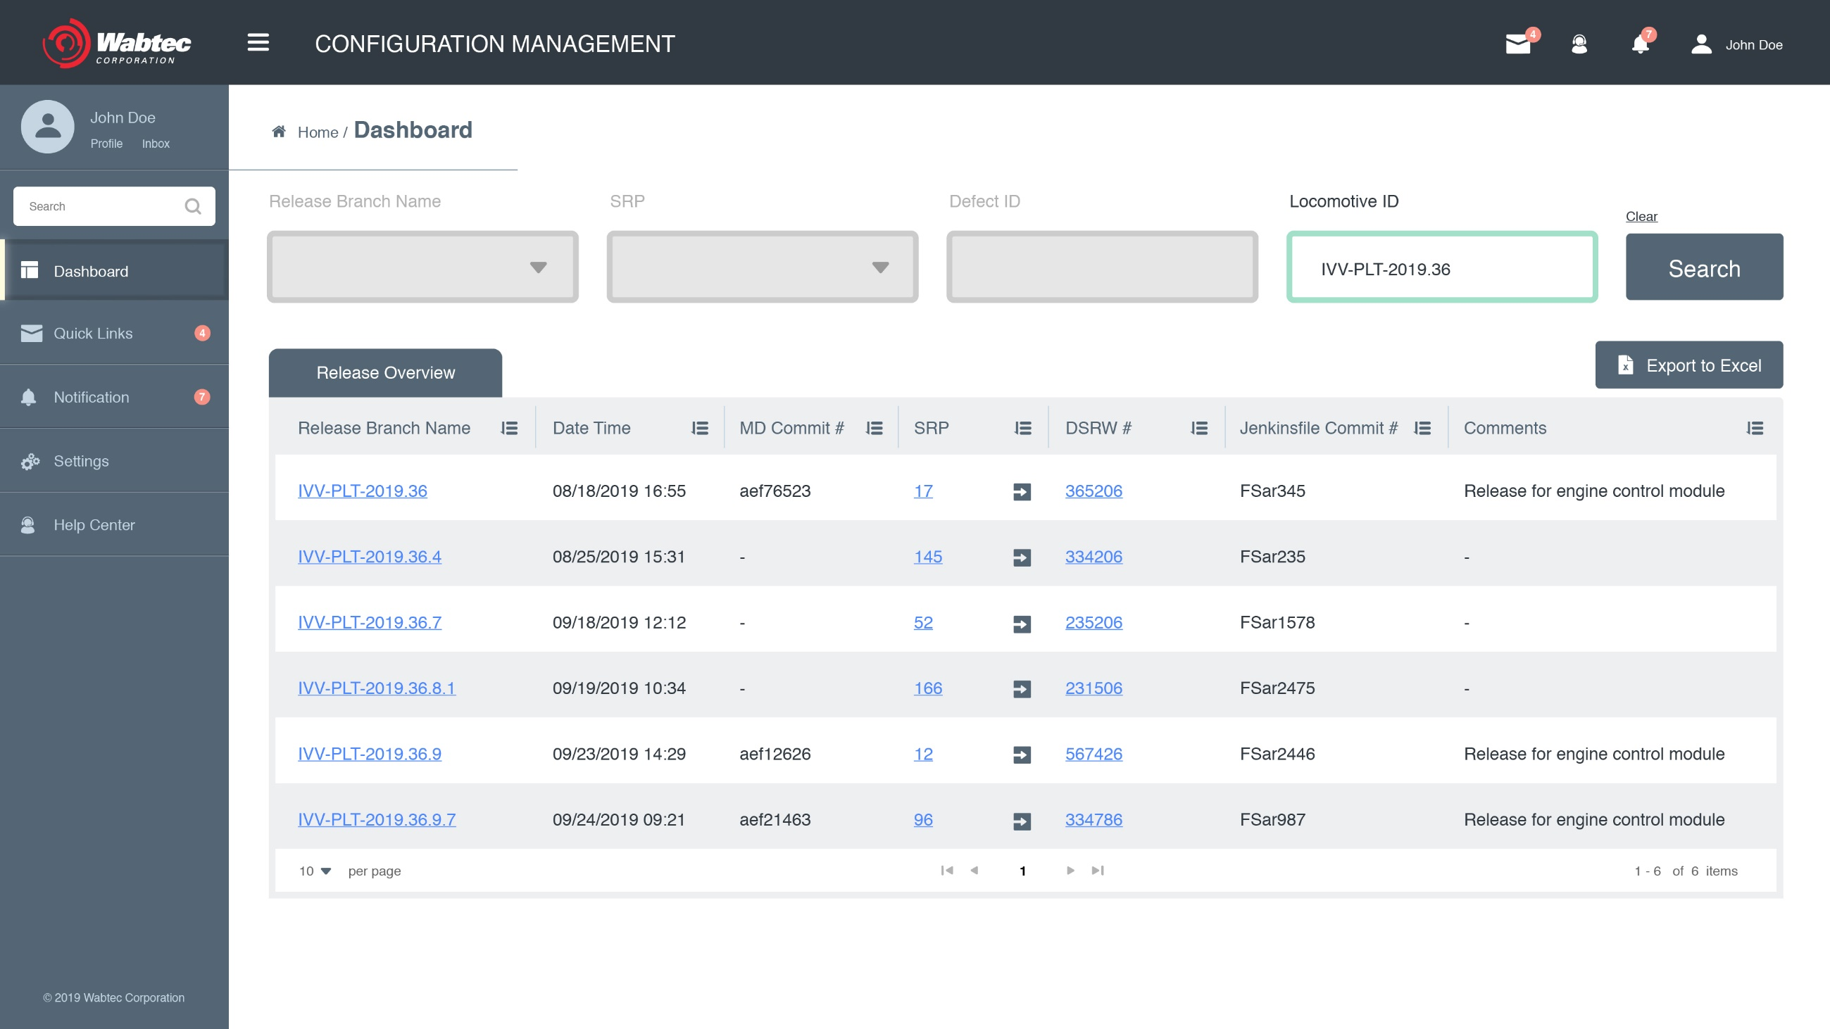
Thinking ahead.. (Future Sprints)
1891
Softura Confidential

